Slide 1
Hey Jetson: 10/11

Slide 2
Agenda
Hardware Layout
ESP32 Software Layout
Training Data
Machine Learning Model

Slide 3
Agenda
Hardware Layout
ESP32 Software Layout
Training Data
Machine Learning Model

Slide 4
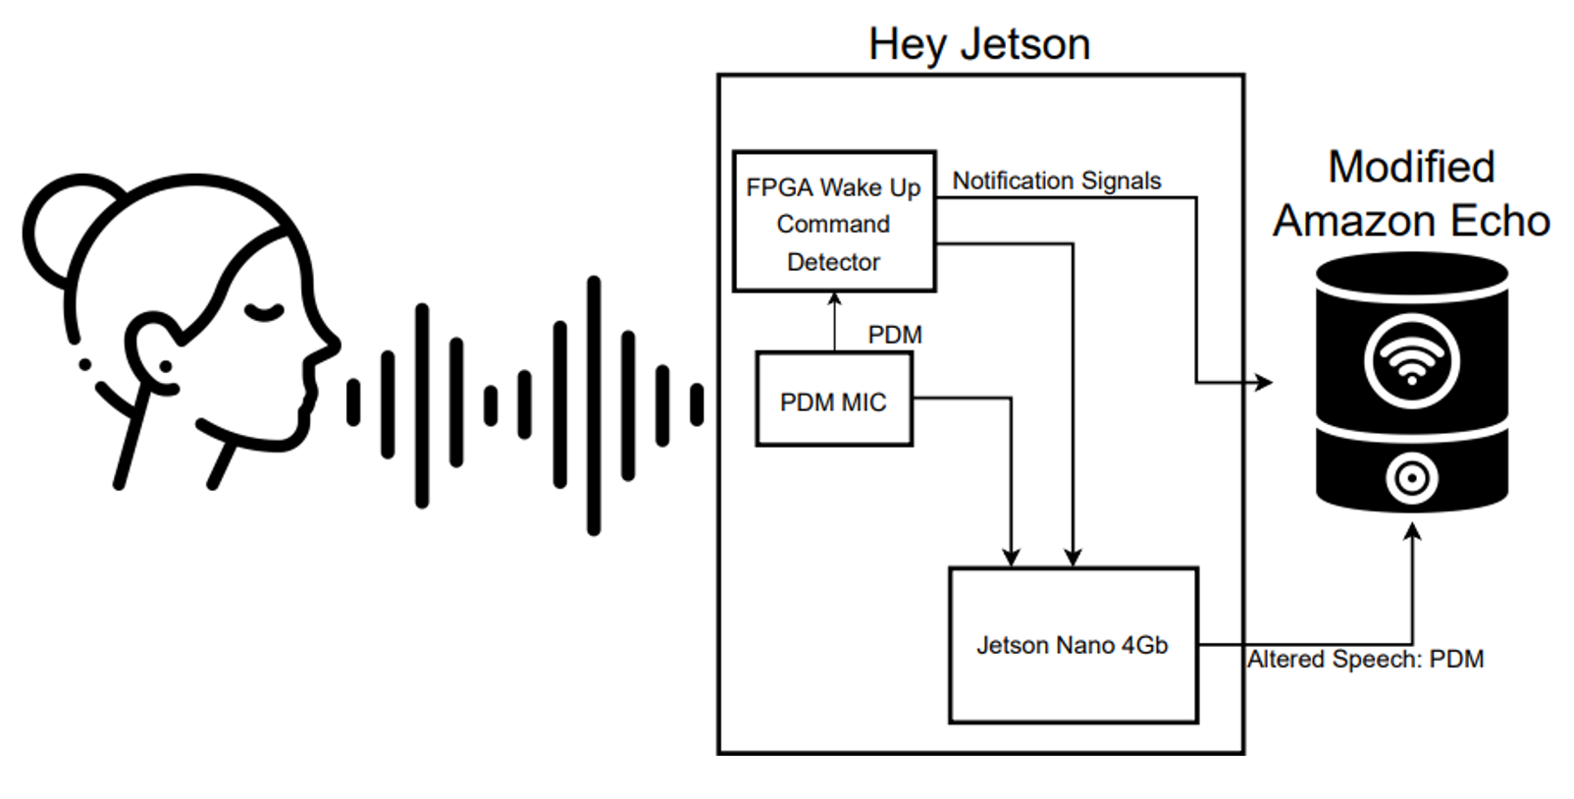
Hardware Layout

Slide 5
Agenda
Hardware Layout
ESP32 Software Layout
Training Data
Machine Learning Model

Slide 6
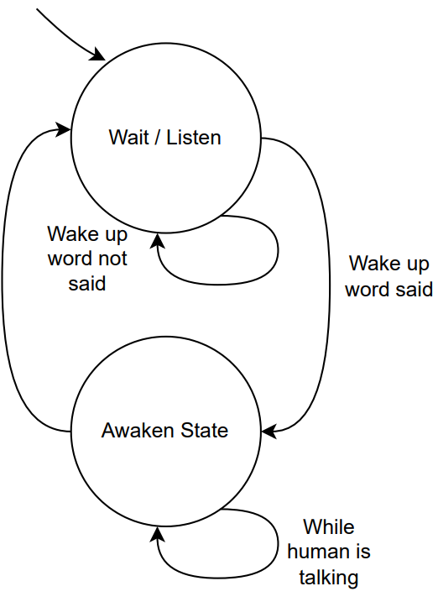
ESP32 Software Layout
Wait / Listen State
Retrieve PCM input from DMA buffer.
Preprocess buffer.
Send value to CNN Model and check classification.
Awaken State
Retrieve PCM input from DMA buffer.
Measure the buffer against some threshold to guarantee the full command is heard.

Slide 7
Agenda
Hardware Layout
ESP32 Software Layout
Training Data
Machine Learning Model

Slide 8
Training Data
35 Classes total. 16000 sampling frequency
76364 training data
8947 validation data
10083 testing data
For a binary classifier (wake word / no wake word, the dataset is heavily unbalanced. We need to use data augmentations to balance it.

Slide 9
Agenda
Hardware Layout
ESP32 Software Layout
Training Data
Machine Learning Model

Slide 10
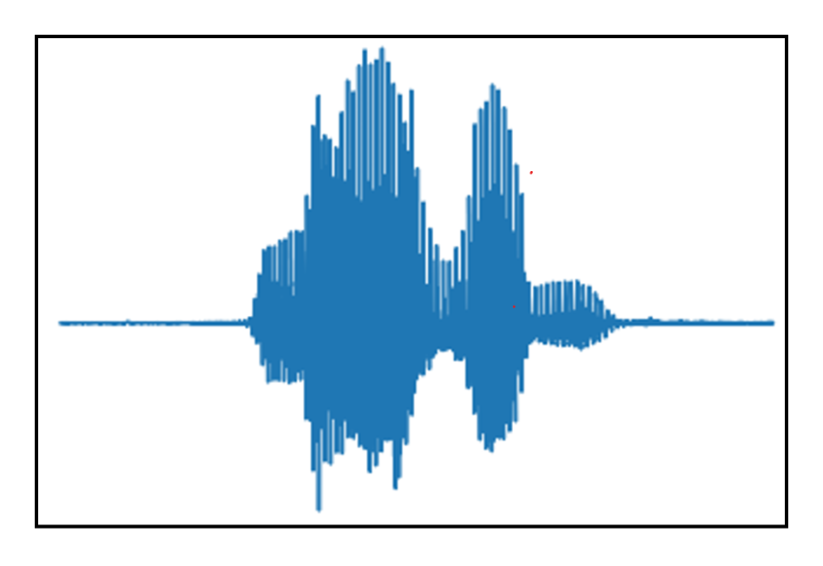
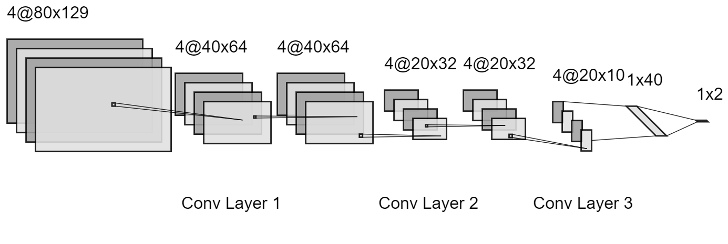
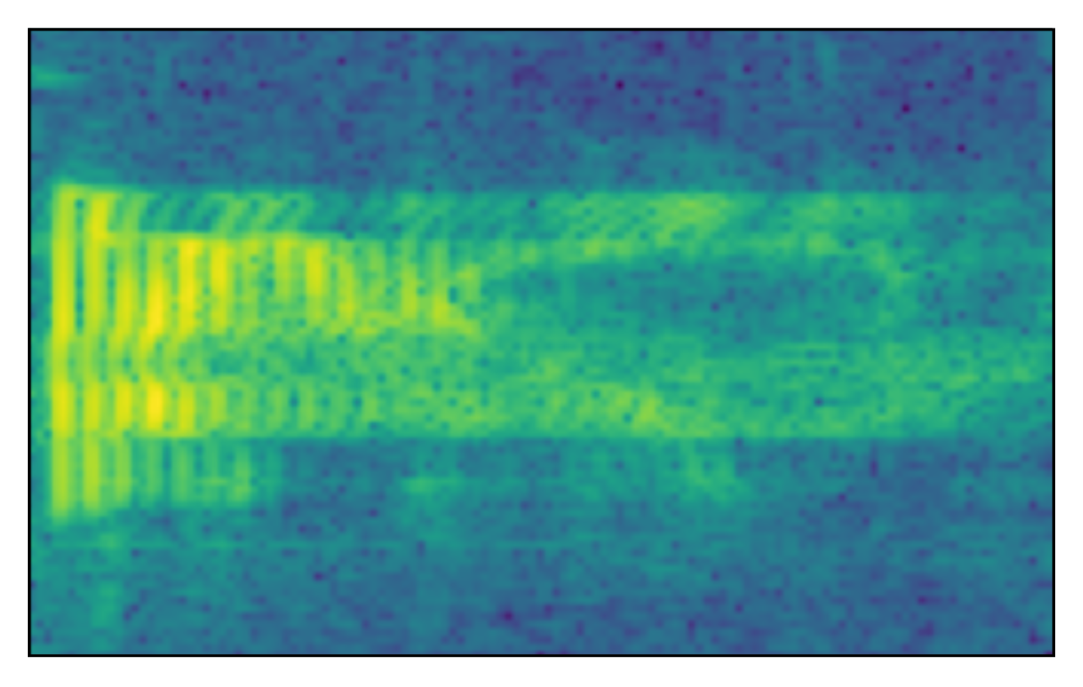
Machine Learning Model: Pipeline and Model Architecture
Spectrogram with Log scaling
Convolutional Neural Network: 26,058 Parameters total

Slide 11
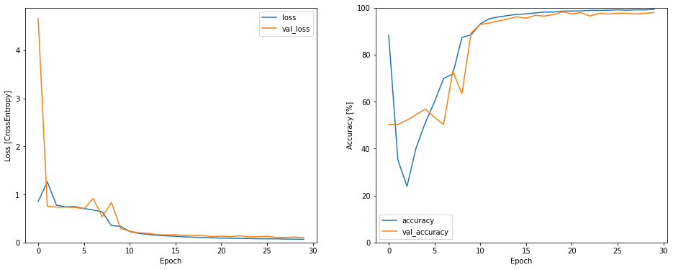
Machine Learning Model: Training Results

